Slide 1

Hàm strcmp,strncmp
- so sánh chuỗi

Slide 2
Hàm strcmp
*So sánh 2 chuỗi s1 và s2 theo nguyên tắc thứ tự từ điển. Phân biệt chữ hoa và thường.Trả về :
0 : nếu s1 bằng s2.
>0: nếu s1 lớn hơn s2.
<0: nếu s1 nhỏ hơn s2.
strcmp(char s1[],char s2[]);

Slide 3
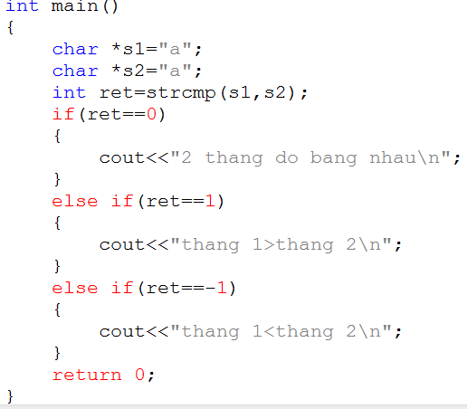
Hàm strcmp

Slide 4
Hàm strncmp
int strncmp(const char *str1, const char *str2, size_t n)
str1 − This is the first string to be compared.
str2 − This is the second string to be compared.
n − The maximum number of characters to be compared.
0 : nếu str1 bằng str2.
>0: nếu str1 lớn hơn str2.
<0: nếu str1 nhỏ hơn str2.

Slide 5
Hàm strncmp
char str1[15];
char str2[15];
int ret;
strcpy(str1, "abcdef");
strcpy(str2, "ABCDEF");
ret = strncmp(str1, str2, 4);
if(ret < 0) {
printf("str1 is less than str2");
} else if(ret > 0) {
printf("str2 is less than str1");
} else {
printf("str1 is equal to str2");
}

Slide 6


Hey! Coding is easy!
END

